Slide 1
Web Application Security

Slide 2

Agenda
Introduction
Client Server vs. Web
Security Areas
Threats
Password Cracking
Interpreter Injection
Session Hijacking
Notes:
Introduction
Explain the scope of the session
Client Server vs. Web
A lot of Uniface applications are currently client server
Security Areas
General overview of the sorts of areas we need to consider when talking about web security
Threats
Password Cracking
Interpreter Injection
Session Hijacking
Examples where possible and demonstrations of how to code for the threat in Uniface
If you could keep questions until the end, we’ll have a Q&A session then

Slide 3
Why Bother?
Internet facing web applications
Internal web applications
Increasingly a developer role
Good tooling helps improve security
Notes:
Why are we worrying about this? Tightening security doesn’t add features, doesn’t improve performance or fix bugs.
Fact is, security is critically important in all types of application
Public web applications
By definition accessible to every bad person with access to the internet
Different type of issue - Not random problems or stupid end users, you’re dealing with people actively trying to break your application
Internal web applications
Maybe only accessible to employees but you need to consider disgruntled employees or disinterested contractors
Still laws, regulations and standards that enforce good practice and security
Security is increasingly the domain of application developers
Not something that can be plugged in afterwards
Applications need to be secure by design
Software development processes need to encourage a security culture. From design to testing to deployment. So we all need to be aware of these issues.
We’re going to look at how tools like Uniface can do a lot of the hard work for you
At the end of this presentation you will have a good understanding of the functionality and features in Uniface that help keep your application secure

Slide 4
Introduction
Huge topic
Taking a developer point of view
Looking at Uniface based solutions
Example code
Notes:
How this is going to work
Huge topic
It’s not the intention to cover everything, but will cover things that are relevant to the majority of Uniface web applications and get you thinking about the sorts of issues out there
Taking a developer point of view
We’ll be covering security concerns from a developer point of view (not so much deployment / configuration of web servers, firewalls, DMZs etc.)
Looking at Uniface based solutions
There might well be ways of combating threats with tools outside of Uniface
But we will cover things like Tomcat features that can be accessed directly from Uniface.
Examples are designed to demonstrate the concepts not as examples of absolute best practice
For a relatively short session like this I think focusing on concrete examples of threats is most useful, so we’ll briefly discuss the theory and then get into some examples.

Slide 5
Client Server vs. Web
Stateless
No control over client
Network is part of the application
Notes:
Security is important in client server applications. We still need to worry about things like user management, but web applications present some unique security challenges
Stateless
Web applications are built over HTTP, which is a stateless protocol
This means that each request has no knowledge of the requests that went before it and therefore the state of the application
The application is responsible for tracking the state of each user. We do this by passing session information to the client, which can be vulnerable to tampering and misuse.
No control over the client
Users access your application using a browser of their choice
This is challenging enough when it comes to ensuring everything works well in all the possible clients your users connect with
When we consider that malicious users can use clients specifically designed to find and exploit holes in our application things get a little more interesting.
Network is part of the application
As well as the client we need to look at the infrastructure connecting the client with our application on the server
For example, an innocent user could be compromised by a third party looking at traffic flowing over the network.

Slide 6
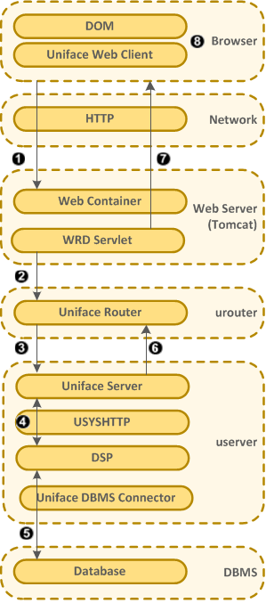
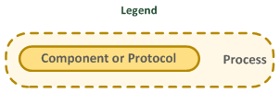
Overview
Notes:
More parts to be exploited
Visual show additional complexity of a web application
Taken from Uniface help documentation, quite a good discussion and a lot of material to read there. I can recommend it.
It’s all under the topic “Web Security Guidelines”

Slide 7
Security Areas
Some areas we need to consider:
Authentication
Authorisation
Browser Security
Session Management
Data I/O
Configuration and Deployment
Notes:
Before we get onto specific examples it’s useful to quickly run down of the sort of security areas we need to consider in a web application:
Authentication
Checking identity– ensuring people are who they say they are
Authorisation
Who has access to what
Browser Security
How browsers behave and being aware of threats targeting the user’s client
Session Management
As we’ve already discussed, the application needs to track a user’s session across multiple requests. The mechanisms used to do this need to be secure against attack
Data I/O
Any data coming from the client is suspect. Anything in a request needs to be checked and sanitised before you do anything with it
Data being passed back out to the client can potentially be read by anyone with access to the client or the network in between
Configuration and Deployment
Covers issues specific to web applications like ensuring that your web server is configured in a secure way (to give a very simple example)

Slide 8
Threats
Password Cracking
Interpreter Injection
SQL Injection
JavaScript Injection
Parameter Manipulation
Session Hijacking
Notes:
As I’ve said, a huge topic so we’re just going to take a look at some specific threats and how we can protect ourselves against them
Password Cracking
Interpreter Injection
SQL Injection
JavaScript Injection
Parameter Manipulation
Session Hijacking

Slide 9
Password Cracking
These attacks include techniques like:
Brute forcing the login page (remotely)
Brute forcing the database with common passwords
Brute forcing the database with rainbow tables
Notes:
Password Cracking
Not exclusively a web problem. We need to consider these issues anywhere we’re storing passwords and asking users to login. But it’s very important so worth covering.
Here we’re talking about issues like:
Brute forcing from the login page
Brute forcing the database using common passwords
Brute forcing the database using pre-computed hash tables
We can look at these individually now

Slide 10
Brute Force
Simply trying a lot of passwords at a login page
Basic protection include:
Throttling login requests
Logging failed attempts:
Locking out accounts
Issuing a CAPTCHA
Password policies
Notes:
First off, brute forcing from the login page. Trying lots of passwords manually or with a script
Things we can do to mitigate this attack:
Adding a small pause after each failed request
Logging failed attempts
Locking out an account after a number of failed login attempts prevents an attacker trying more than 5 or so passwords per user
Making the user solve a CAPTCHA
“Completely Automated Public Turing test to tell Computers and Humans Apart”, that’s the squiggly lines and numbers
Essentially prevents an attacker from using a script to try passwords because computers shouldn’t be able to solve CAPTCHAs.
Password policies can make passwords harder to guess

Slide 11
Cracking Hashed Passwords
Attacker has access to the user database
Plain text passwords make abuse trivial
Passwords should be properly hashed
Notes:
If an attacker gains access to your user database there are a number of ways they can use this information to get at user passwords and therefore gain access to your site.
If an external attacker has gained access to your user database then you might very well have larger problems but for the purposes of these examples we can assume that a list of usernames and passwords have been leaked somehow that doesn’t compromise the entire application
Obviously if the user passwords are stored in plain text then it’s trivial to read them and access a user’s account
The purpose of password hashing (in the context of a website) is not to protect the website from being breached, but to protect the passwords if a breach does occur - maybe even just a malicious employee looking for passwords to try on other sites.
It’s also worth remembering that users will tend to reuse passwords, so even if your application has been completely compromised there is a certain amount of responsibility to make it harder for an attack to gain access to other sites the user reused his password on.

Slide 12
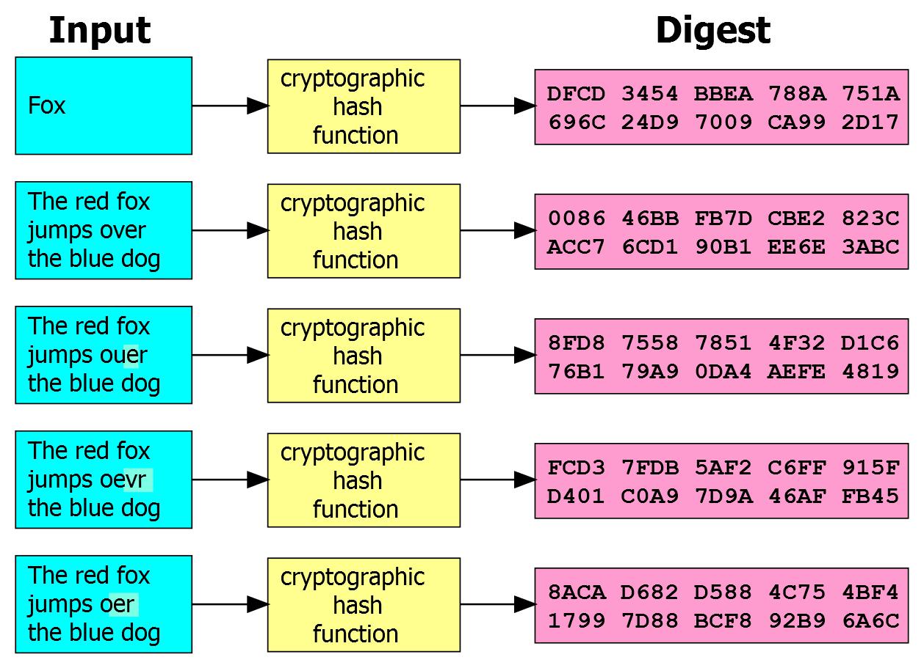
Password Hashing Basics
Notes:
This simple diagram shows how hashing algorithms work.
Small changes in the input create completely different output.
Not possible to go from the Digest back to the Input

Slide 13
Demo
Storing Passwords
Notes:
Demo
Open “1. Password Hashing”
Open SEC_PWD_CRACKING in IDF
Look at the 3 types of hashing
Show how easy the first passwords are to crack using CrackStation

Slide 14
Uniface
sleep
$webinfo(“WEBSERVERCONTEXT”)
$encode
LDAP driver
Notes:
Let’s recap the Uniface features we just looked at which help with authentication and password security
sleep
Pause execution to make brute forcing a login page harder
$webinfo(“WEBSERVERCONTEXT”)
Getting request information like remote IP
$encode
Hashing algorithms for storing passwords
We haven’t discussed the last one, but it raises an interesting point. Rather than designing these things yourself, it’s often best to use some industry standard technology.
LDAP driver
There’s no point rewriting something if someone has already done it for you
Most of us wont’ be able to do it better than dedicated software

Slide 15
Threats
Password Cracking
Interpreter Injection
SQL Injection
JavaScript Injection
Parameter Manipulation
Session Hijacking

Slide 16
Interpreter Injection
These attacks include techniques like:
SQL Injection
JavaScript Injection
Parameter Manipulation
Notes:
Interpreter Injection
Interpreter injection covers a range of threats which aim to make the application parse and execute code provided by an attacker
SQL Injection
JavaScript Injection
Parameter Manipulation
I’ll cover all 3 types and then look at what Uniface does to protect your applications

Slide 17
SQL Injection
ID: 1
Date of Birth: 23-feb-1982
Name: Robert
INSERT INTO students VALUES
(1, ‘23-feb-1982', ‘Robert');
Notes:
SQL Injection
Let’s look at a very simple SQL insert operation
We have a table with the columns ID, Date of Birth and Name.
We want to insert the data at the top of the slide into the table and we might use an SQL statement like this one

Slide 18
Demo
SQL Injection
Notes:
Demo
Open SQL Server Management Studio
Open SEC_SQL_INJ_01 and look at Store
Run SQL Injection 1
Add a record
Show it in the database
Add using the injection string
Show that table has been dropped
Open SEC_SQL_INJ_02 and look at Store
Run SQL Injection 2
Add using the injection string
Show it in the database

Slide 19

SQL Injection
ID: 2
Date of Birth: 13-Nov-1973
Name: Robert'); DROP TABLE students;--
INSERT INTO students VALUES
(1, ‘23-feb-1982', ‘Robert');
--’);
DROP TABLE students;
Notes:
What went wrong here?
A malicious user entered an engineered string into the name field
User entered that string into the Name field.
It got interpreted by the SQL function
Not going to be a massive problem in a Uniface application, but people do use the SQL command.

Slide 20
JavaScript Injection
Getting a browser to execute unintended JS
Usually injected where user input is allowed
Malicious code runs for anyone visiting the page
The code appears to have come from the application
Notes:
JavaScript Injection revolves around getting a victim’s browser to run the attacker’s JavaScript
The usual attack vector for these attacks is places where user input is allowed.
An attacker will attempt to get their script displayed back into the browser (think forums, commenting systems)
Runs for anyone in the case of persistent attacks
Which means it runs with the privileges of the application, which is the dangerous part

Slide 21
Demo
JavaScript Injection
Notes:
Demo
Open “JavaScript Injection”
Show adding some text with basic formatting
Using Raw HTML fields
Grab injection string from security snippets and add that
Grab session sidejack string and add that
Change menu.json to “APP_FORUM”
Refresh page and see string being properly escaped
Using static text widgets

Slide 22
Parameter Manipulation
User has control of the browser
JavaScript based validation can be bypassed
Requests can be sent at any time to:
Any Public Web operation
Any Public Trigger
Notes:
Parameter Manipulation
These attacks revolve around the fact that you can’t control what the user sends to your application
Not strictly a parameter manipulation attack, but any JavaScript validation can be by-passed by an end user. The code is running in their application (their browser)
We also need to consider that users can submit hand made requests to any public operation or trigger in your application
Data coming in on these interfaces needs to be treated with the appropriate amount of trust (i.e. don’t trust it!)

Slide 23
Demo
Read Only Fields
Notes:
Demo
Not strictly a parameter manipulation attack, but it illustrates the same principle
Going to look at how Uniface protects read-only fields
Open SEC_READ_ONLY in IDF
Look at the properties of each field
Open page in browser
Hack read-only property of READ_ONLY_1 using security snippet
Change and submit
Hack read-only property of READ_ONLY_2
Change and submit
See hash error message

Slide 24
Uniface
SQL Injection
Database drivers prevent SQL injection
JavaScript Injection
Widgets correctly escape HTML
Any Public Web operation
Any Public Trigger
Parameter Manipulation
Model definitions used for validation at each step
Read-only field handling
Public web / Public trigger
Standard triggers
Notes:
Again, let’s recap what we’ve discussed and look at the Uniface features that provide protection in these areas.
SQL Injection
The database driver layer prevents SQL being injected
The only vulnerable command is the SQL proc statement, which you can audit for with a simple search of your source code repository.
JavaScript Injection
Anything displayed in a Uniface widget will be handled correctly.
The only widget to be concerned about is the raw HTML widget, which allows you to put whatever you want out to the browser
Again, it’s trivial to query your repository database and find where raw HTML fields are being used
DSPs generally not vulnerable due to the way data is added (dynamically with JavaScript). More of a side effect than a feature, but it’s why I had to use a USP in the demo
Parameter Manipulation
The Uniface model provides a single place to define field validation. This is then applied client-side and server-side for you automatically.
Uniface enforces read-only behaviour on fields you’ve defined as read-only
These fields are protected using a salted MD5 hash and will automatically trigger a security error upon a webload if these have been tampered with
Standard triggers
Pre-request – request level validation
Get state - DSP level validation

Slide 25
Threats
Password Cracking
Interpreter Injection
SQL Injection
JavaScript Injection
Parameter Manipulation
Session Hijacking

Slide 26
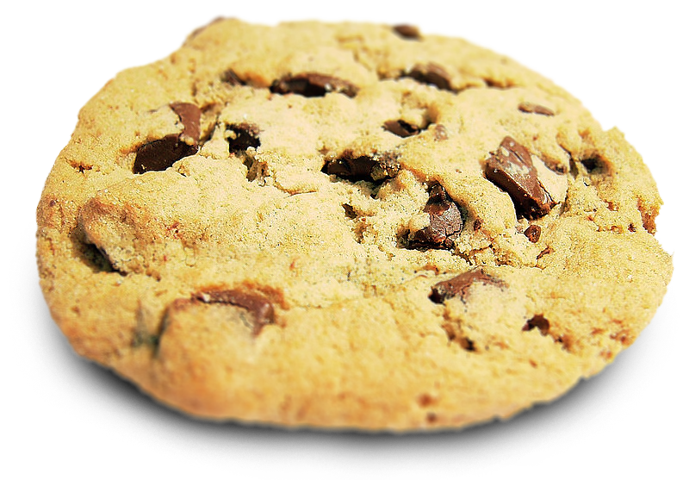
Session Hijacking
These attacks include techniques like:
Session Fixation
Session Sidejacking
Physical Access
Notes:
There are a number of types of session hijack attack. They revolve around knowing a user’s session ID so that you can impersonate them:
Session Fixation
Forcing a victim to use a known session ID
For example, sending the user an email with a link that contains a particular session ID
The attacker then just has to wait until the user logs in before using the now authenticated session ID for himself
Session Sidejacking
An attacker can compromise the session ID while a user is already logged in.
Could use a man in the middle attack to read network traffic going between the browser and server
Firesheep – Firefox extension that when used on an open wi-fi network let you sniff Facebook sessions and log in as people. Before Facebook went HTTPS.
Could use JavaScript injection to grab a logged in user’s session ID, which I’ll demo in a moment
Physical Access – simply steal the session ID
Looking over someone’s shoulder
Copying a cookie or memory

Slide 27
Demo
Session Sidejacking
Notes:
Demo
Demonstrate how we’re doing session handling in the sample application
Show what happens with cookies when logging in
The session ID is changed when we log in, making session fixation hard
Logging out kills the session, gives the user a secure way to end their session
Show how a session ID can be grabbed using cross site scripting and used to log in

Slide 28
Uniface
Tomcat session handling
$webinfo(“SESSIONCOMMANDS”)
$webinfo(“WEBSERVERCONTEXT”)
HTTP only cookies by default
Notes:
A lot of this comes down to good application design, having a good session management strategy. However, Uniface gives you the tools to do it easily:
Tomcat session handling
Session Fixation
Largely solved by changing the session ID - $webinfo(“SESSIONCOMMANDS”)
Session Sidejacking
Can be mitigated by using information in WEBSERVERCONTEXT in checks, things like remote IP address.
This lets you check that the session ID is being used by the person you sent it to
The default Tomcat configuration also uses secure cookies by default
So the demonstrated attack wont work out of the box

Slide 29
Summary
Security needs to be designed in
Good tooling helps improve security
What else?
Security audits
Vericode – regular security testing
Notes:
Certain issues as developers we just need to be aware of so we can design and code for them
However, as we’ve seen, Uniface can do a lot to protect an application “by default”.
We’ve discussed how using industry standard tools can be more reliable than writing your own solution. Uniface is no exception.
Just want to quickly cover some of the other on-going activities we undertake
Security audits take place on customer applications all over the world, all the time. Where possible Uniface can make improvements which benefit the entire customer base.
We work with a company called Vericode who carry out regular security tests on Uniface Web
In the future we’ll be integrating this directly into Uniface’s build process so the checks are carried out even more frequently

Slide 30
Thank You! Questions?

Slide 31
Notes:
Thank you

